Slide 1

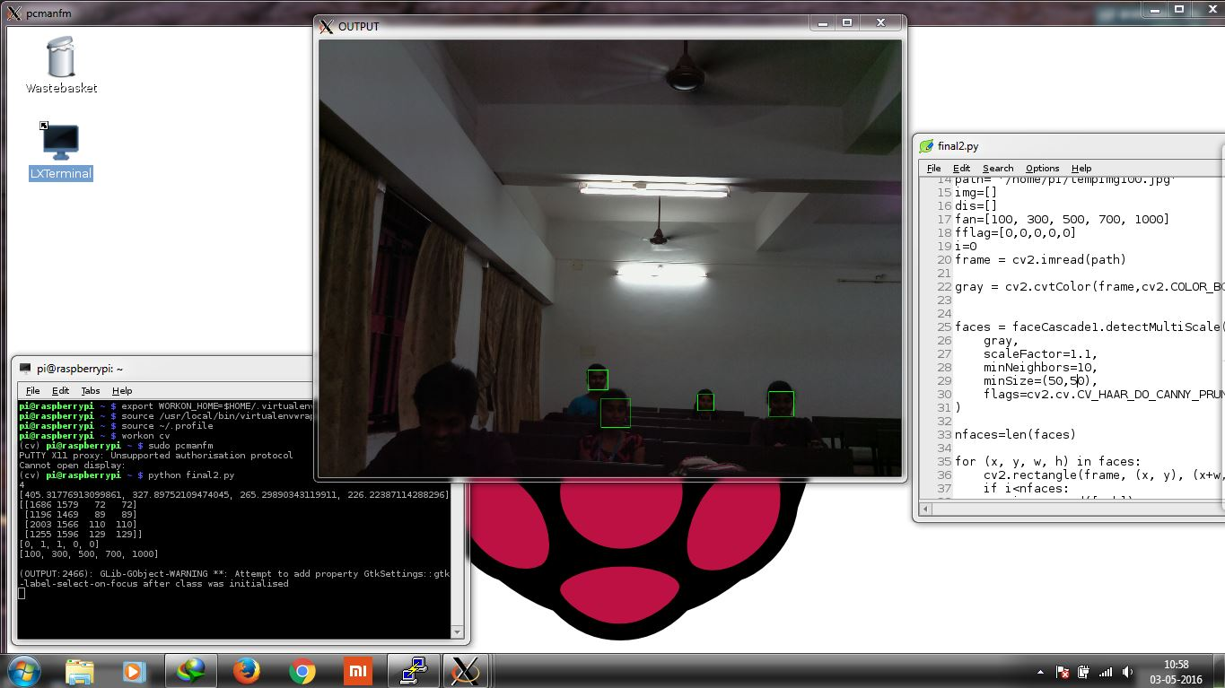
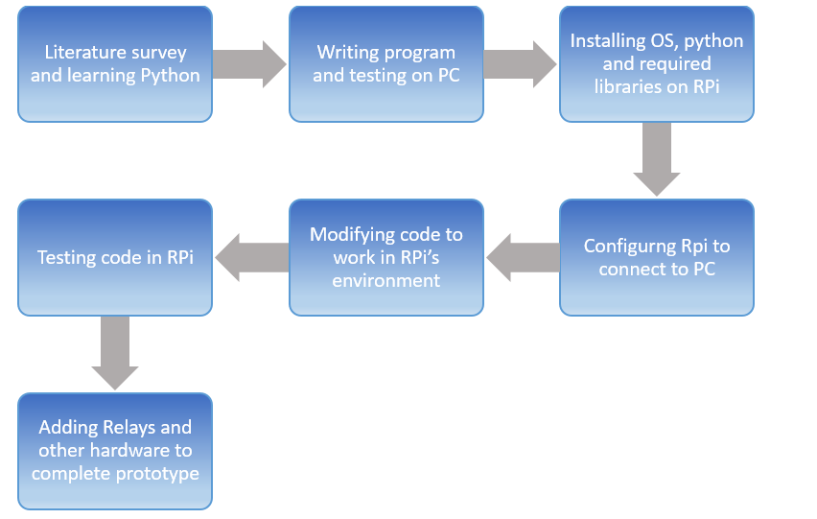
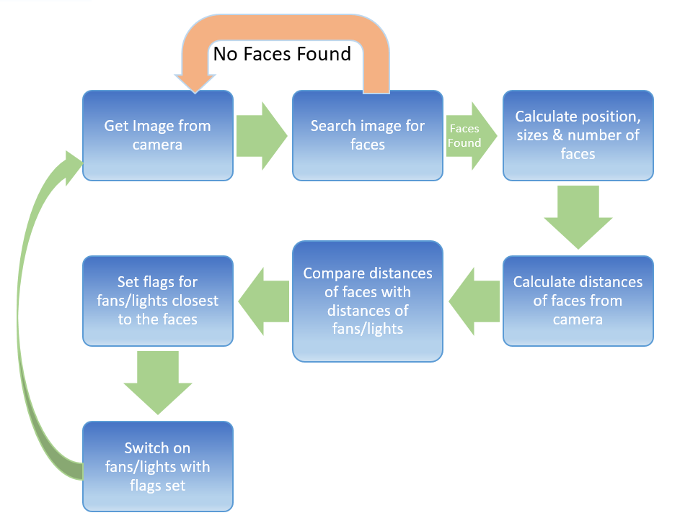
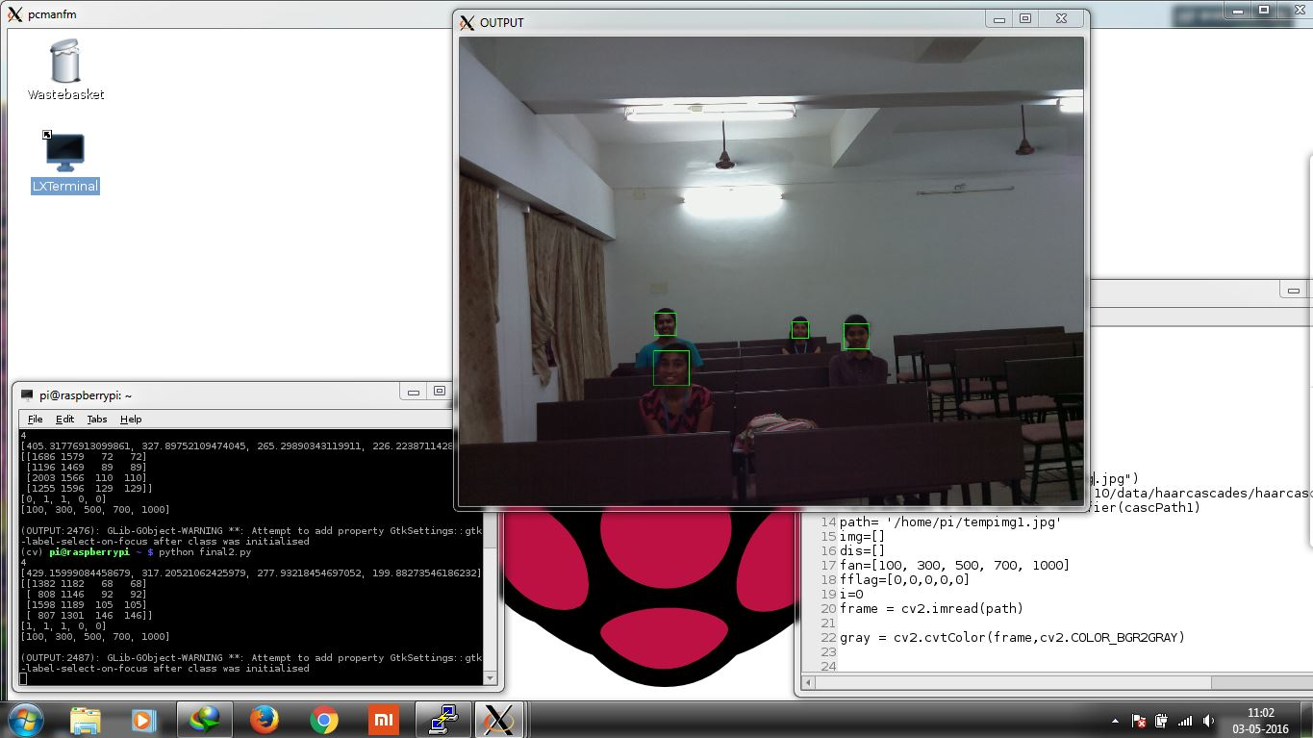
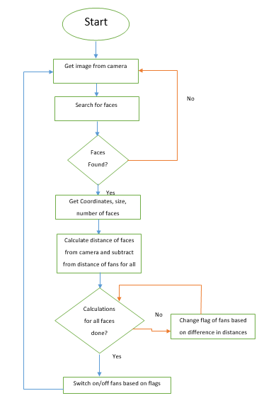
CLASSROOM AUTOMATION
K. HIRANYA GARBHA , B. SANDEEP KUMAR | Prof. KARTHIKEYAN. B| SENSE
Motivation/ Introduction
Results
. This project aims to solve one of the most common problems faced by the University: wastage of electricity in form of unnecessarily running fans and lights. We frequently find that even when no one is in the classroom, the fans and lights in the room are all switched on. A similar scenario can be found in hostels too, where some students often lock the room when they are not present and don’t bother switching off fans and lights. A solution to this ubiquitous problem class room automation.
.
As it is clearly visible, the detected faces are highlighted by green rectangles. We have assumed 5 fans in this scenario. The terminal window in the bottom right shows the values of different parameters:
1st Line: Number of faces detected in the picture – 4
2nd Line: Distance of the faces from the camera (in cm) – 405, 327, 265 and 226.
3rd Line: The coordinates of the faces as well as the dimensions of the rectangle-
4th Line: The flags indicating the status of each fan (1 - fan is on, 0 – fan is off) – [0, 1, 1, 0, 0]
5th Line: Assumed distance of the 5 fans from the camera (in cm) – [100, 300, 500, 700, 1000]
From the results in the above image, we can see that the algorithm is working well. It detects 4 face, highlights them, calculates distance from each fan and then decides which fans should be off and which should be on based on the difference in distance from the fans and the faces.
The following are a few more images demonstrating the same results at different distances, number of people, and lighting conditions.
In a well illuminated classroom:
SCOPE of the Project
This project is aimed at reducing the wastage of electricity in the university campus. Students usually hurry to their next classes and forget to switch off lights and fans in the classroom. This contributes to a lot of electricity wastage. With non-renewable energy sources steadily depleting, renewable energy sources still unreliable & under development and carbon emissions from electricity production contributing to global warming and green house effect, conserving electricity and preventing its wastage is of prime importance. This project if implemented (after overcoming its limitations) can significantly contribute to electricity savings and thus help us reduce greenhouse emissions and electricity bills
Methodology
This system consists of software as well as hardware components:
• Hardware: Raspberry Pi 2, NoIR Camera
• Software: OpenCV, Python
The system uses Raspberry Pi 2 as the main computing hardware. The NoIR camera has been used to overcome low-light conditions and other illumination problems. Due to the lack of having a monitor with HDMI input and a keyboard, we have used Xming and PuTTY to connect the Pi to the laptop and use the laptop’s I/O devices for the Pi.
Design stages
Project working flow chart
programming flow chart
Code working:
The system first takes an image from the camera. It then searches the image for faces using a specific range of window sizes and min. neighbours. When a face is found, its coordinates and dimensions (of the window) are stored in an array. The dimensions of the face are then extracted from the array and are used in the distance formula to get the distance of the face from the camera. This process is repeated for each face and the distances are stored in an array. The distances are then compared one by one to all the elements of the array containing the distance of fans from the camera, and the flags of the particular fan (whose distance is being compared) is set if the difference in distances of the face and the fan is less than 100 cm. This process is repeated for all fans. The final array containing the flags for the fans is used to give output to the respective fans thru Pi’s GPIO pins. The whole process is repeated in an infinite loop.
Conclusion/ Summary
We have successfully designed a system using Raspberry Pi & NoIR Camera as hardware and Python & OpenCV as software used. The system we designed is working as intended and is giving good results in controlled environments, though it still has a lot of limitations and improvements to be done for making it workable in a real-time and practical scenario. The output image shows the detected faces highlighted by green rectangles and results give the various other information such as distance, number of faces, status flags of the fans etc. The accuracy of the system depends on the accuracy of the face detection algorithm used. Since we have only used frontal face cascade due to limitations in processing power and latency, the accuracy in a general scenario is about 50%, whereas it is above 90% in controlled situations.
Contact Details
kumarhiranya.garbha2012@vit.ac.in, burrasandeep.kumar2012@vit.ac.in
Acknowledgments/ References
Motion_Detection_Programming_Guide_V1.1 GM8126
Moorhead, Joanna.(2012). "Raspberry Pi device will reboot computing in schools'". The Guardian (London).

